Slide 1
IBM Rational Rhapsody Advanced Systems Training v7.5
Modeling DataFlow
Notes:
Course Title - Instructor Notes - Arial Narrow 20pt
Module X - Module Title

Slide 2
Objectives
In this module you will learn:
  How to model data flow using Rational Rhapsody
  How to execute data flow in Rational Rhapsody
Notes:
Course Title - Instructor Notes - Arial Narrow 20pt
Module X - Module Title

Slide 3
Data flow overview
Using Rational Rhapsody, data flow may be modeled in a variety of ways:
  As parameters on Events
    For service based architectures
    Can be executed
  Using SysML Flow Ports
    For more traditional data flow oriented architectures
    Can be simulated
  Information Flows
    Allows abstract data flow modeling
    Will not execute
    May be mapped later to ‘actual’ data items
Notes:
Course Title - Instructor Notes - Arial Narrow 20pt
Module X - Module Title

Slide 4
IBM Rational Rhapsody Advanced Systems Training v7.5
DataFlow Event Parameters
Notes:
Course Title - Instructor Notes - Arial Narrow 20pt
Module X - Module Title

Slide 5
Event parameters - objectives
Identify how data flows by passing data as a parameter on a message.
Trigger behavior with an event – the event has data with it – like a message of information. Use the data to make decisions.

Slide 6
Event parameters model
In this example, you add guard conditions to a trigger in order to test the credit status of a customer when they purchase fuel for a car. If their credit status is “GOOD” fuel pumping can start.

Slide 7
Open a model
Launch Rational Rhapsody
From the menu:
  File > Open
Open the Event Parameters model.
Notes:
Course Title - Instructor Notes - Arial Narrow 20pt
Module X - Module Title

Slide 8
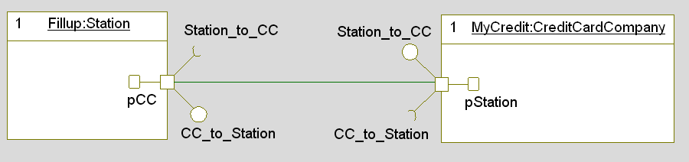
Architecture overview
Expand the Architecture package
Open and examine the System Instantiation Internal Block Diagram
Notes:
Course Title - Instructor Notes - Arial Narrow 20pt
Module X - Module Title

Slide 9
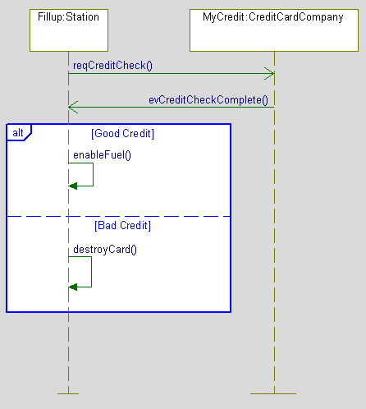
Scenario overview
Expand the AnalysisPkg
Open and examine the sequence diagram
Notes:
Course Title - Instructor Notes - Arial Narrow 20pt
Module X - Module Title

Slide 10
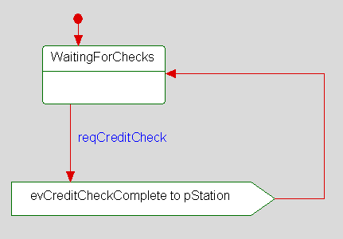
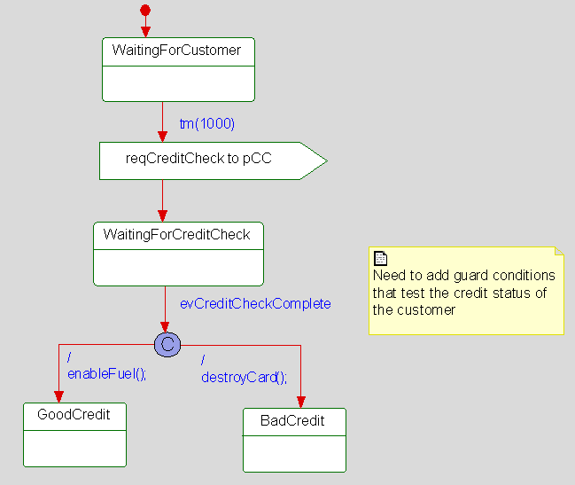
State Machine overview
Examine the State Machines on both the Station and the Credit Card Company
Notes:
Course Title - Instructor Notes - Arial Narrow 20pt
Module X - Module Title

Slide 11
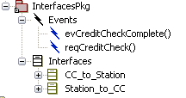
Interfaces and Events
Expand the InterfacesPkg
  Note that the Events do not have any parameters currently - you can see this by looking at the event Features>Arguments tab
  You will now modify the model such that:
    The evCreditCheckComplete Event carries a parameter.
    The Credit Card Company sends parameter data when it sends the Event.
    The Station tests the data in the Event and behaves accordingly.
Notes:
Course Title - Instructor Notes - Arial Narrow 20pt
Module X - Module Title

Slide 12
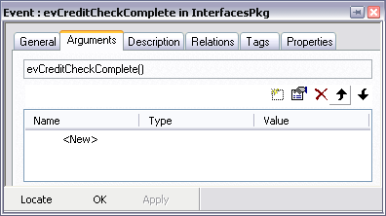
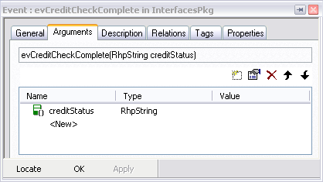
Adding a new Event parameter
Parameters are called Arguments in Rhapsody.
Open the Features View for the evCreditCheckComplete Event
On the Arguments tab:
  Click <New> to add a new argument
  Name it creditStatus
  Change its Type to RhpString and click OK
Notes:
Course Title - Instructor Notes - Arial Narrow 20pt
Module X - Module Title

Slide 13
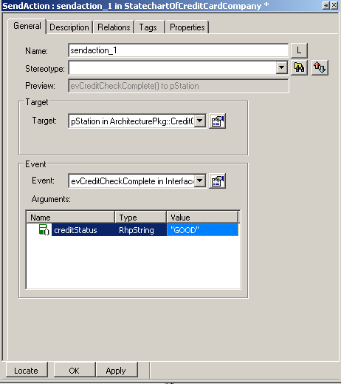
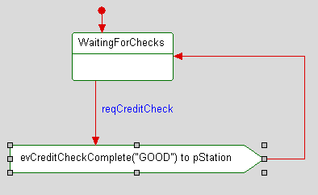
CreditCardCompany State machine
Open the State Machine of the CreditCardCompany
Modify the sendaction to send a particular argument value “GOOD” along with the Event
Notes:
Course Title - Instructor Notes - Arial Narrow 20pt
Module X - Module Title

Slide 14
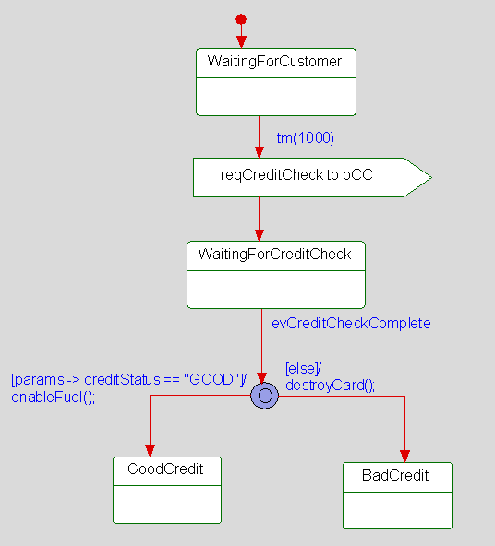
Station State machine
Open the State Machine of the Filling Station.
  Add Guard conditions to the transition that test the incoming Event parameter value
  params -> creditStatus == “GOOD”
Note the use of the params-> syntax to get the value of an event parameter.
Notes:
Course Title - Instructor Notes - Arial Narrow 20pt
Module X - Module Title

Slide 15
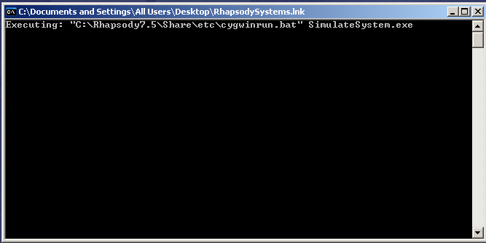
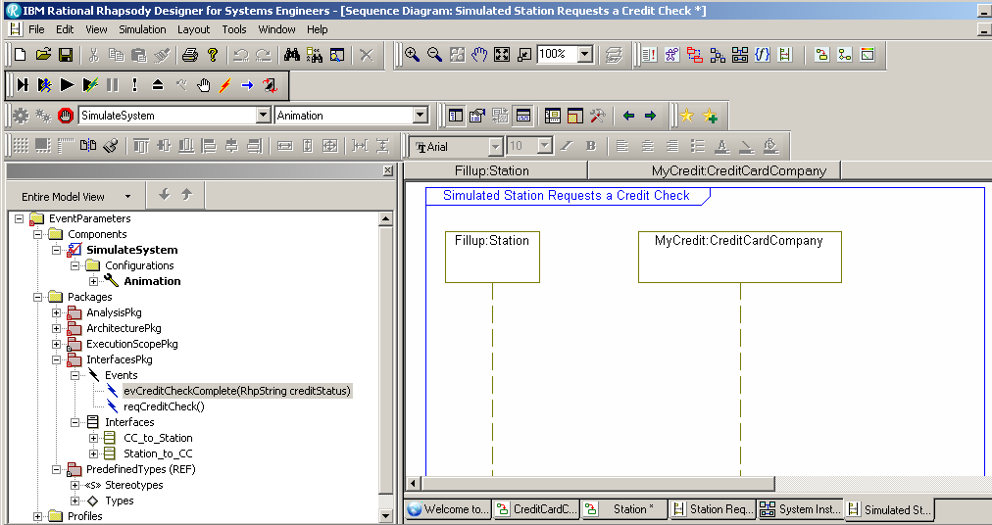
Run a Simulation
Run a Full Build of the model
When the build is successful, the simulation control bar will open to control the animation.
Click the running man icon
to Go.

Slide 16
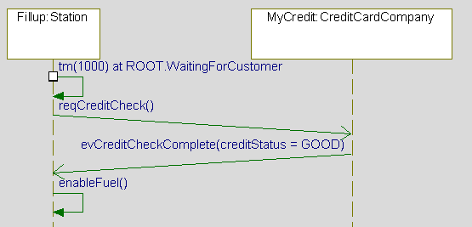
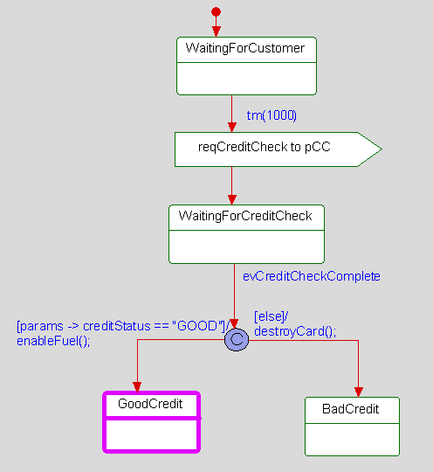
Simulation result
Notes:
Course Title - Instructor Notes - Arial Narrow 20pt
Module X - Module Title

Slide 17

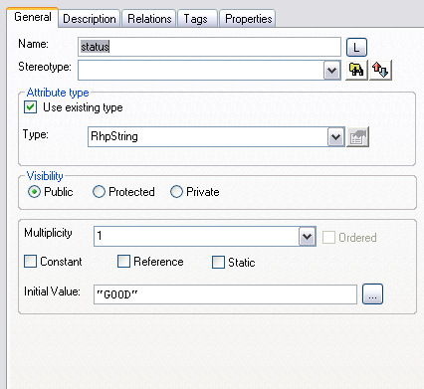
Controlling parameter values
Instead of sending fixed values, Parts can send the value of their own attributes.
  Web-managed attributes may be modified using a web browser.
Add a new Attribute to the CreditCardCompany block in the Architecture package.
Right click on the CreditCardCompany block and select Add New>Block>Attribute.
  Name: status
  Type: RhpString
  Initial Value: “GOOD”
Click OK.
Notes:
Course Title - Instructor Notes - Arial Narrow 20pt
Module X - Module Title

Slide 18
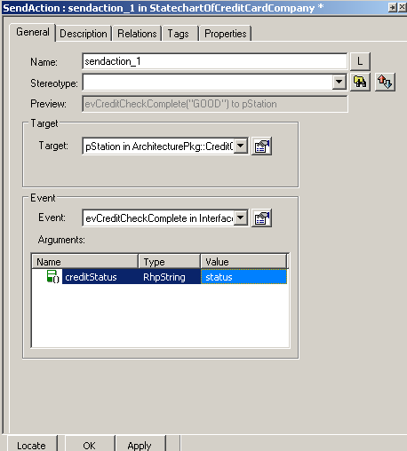
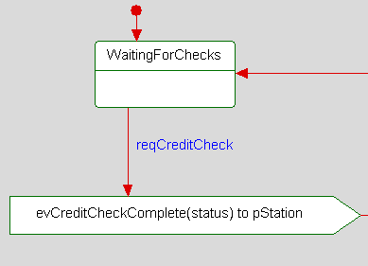
Modify the State Machine
Modify the State Machine of the Credit Card Company to send the status Attribute:
Notes:
Course Title - Instructor Notes - Arial Narrow 20pt
Module X - Module Title

Slide 19
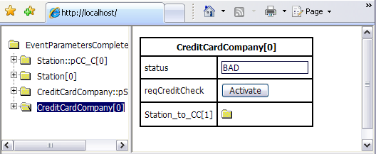
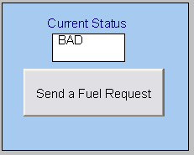
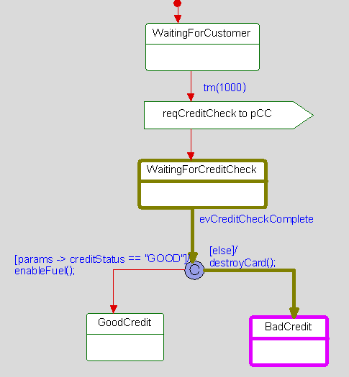
Run a simulation
Rebuild the simulation
Open a web browser and enter http://localhost/
Use a web page to change the value of the Attribute status to BAD
Panel Diagrams may also be used
Notes:
Course Title - Instructor Notes - Arial Narrow 20pt
Module X - Module Title

Slide 20
IBM Rational Rhapsody Advanced Systems Training v7.5
Data Flow Atomic Flowports
Notes:
Course Title - Instructor Notes - Arial Narrow 20pt
Module X - Module Title

Slide 21
Flow Ports refresher
Flow Ports are interaction points – just like Standard Ports.
  Standard Ports carry messages.
  Data, material or energy flows through Flow Ports.
  Flow Ports have direction (in / out / bidirectional).
Flow Ports can be:
  Atomic
    Relays a single usage of a block, value-type, data-type or signal.
    The flow Port is typed by a block, type or signal.
  Non-Atomic
    Relays items of several types as specified by a Flow Specification.
    The flow Port is typed by a Flow Specification.
Notes:
Course Title - Instructor Notes - Arial Narrow 20pt
Module X - Module Title

Slide 22
Flow Ports in simulation – sending data
During model execution:
  When an Attribute value changes, the change will automatically propagate through its corresponding Output Flow Port – provided the set method is used to make the change.
    For example: setReg(“MyReg”)
  Changing the Attribute value directly will not cause the flow
    For example: reg = “MyReg” will not flow
Notes:
Course Title - Instructor Notes - Arial Narrow 20pt
Module X - Module Title

Slide 23
Flow Ports in simulation – receiving data
During model execution:
  If a Block has a Flow Port you may use Change Events.
  Change Events are not added automatically.
  To use Change Events you must define the Event in the Package
    The Event must be named chFlowPortName
  Once defined the Event may be used on that Blocks State Machine.
  When an incoming flow changes an Attribute value the Change Event will be automatically dispatched to the State Machine.
Notes:
Course Title - Instructor Notes - Arial Narrow 20pt
Module X - Module Title

Slide 24
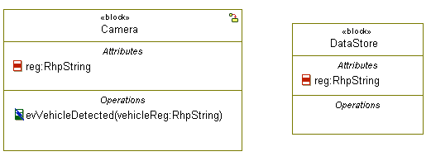
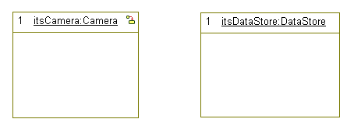
Open a model
Launch Rhapsody.
From the menu:
  File > Open
Open the FlowPorts model.
  Note the architecture.
BDD
IBD
Notes:
Course Title - Instructor Notes - Arial Narrow 20pt
Module X - Module Title

Slide 25
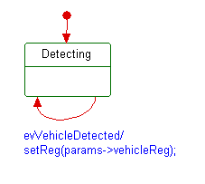
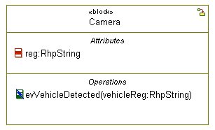
Note behavior
Note that the Camera has a Statemachine
  The evVehicleDetected Event has a parameter (vehicleReg)
  When the Camera receives this event it sets the value of its reg attribute to the value of the event parameter.

Slide 26
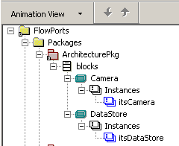
Reminder: steps to build and run a simulation
Do a Full Build of the model
Minimize the DOS window
Step
Select Tool→Simulated Statechart – this will create an animated statechart of the Camera
Once the simulation is running (after a step), examine in the browser the features of the itsCamera instance. You may want to use the Animation View in the browser.

Slide 27

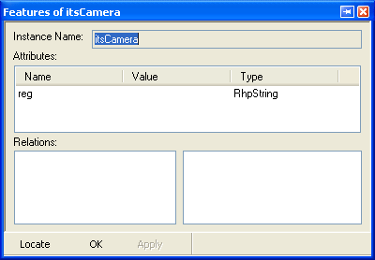
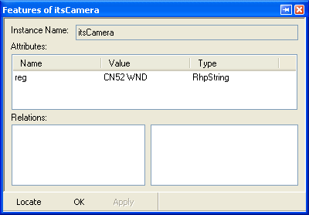
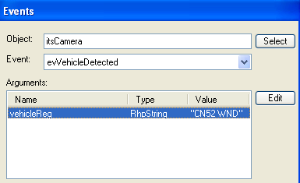
Execute
Build and execute the model
  Confirm that the reg attribute starts empty
  Inject an evVehicleDetected Event – use your own car registration as the parameter
  Confirm that the Camera’s reg attribute changes

Slide 28
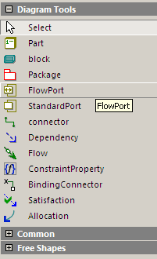
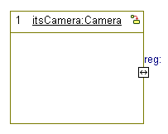
Add a Flow Port
Stop the model execution
On the Internal Block Diagram:
  Select the Flow Port tool.
  Click on the boundary of the Camera Part to create a new Flow Port
  Name it reg
Atomic Flow Ports must have the same name as the Attribute they will carry
Notes:
Course Title - Instructor Notes - Arial Narrow 20pt
Module X - Module Title

Slide 29
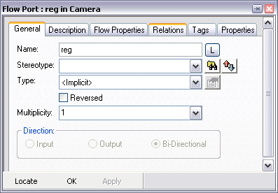
Flow Port features
Open the Features view for the reg Flow Port:
Implicit flow attributes
Direction becomes available when the Port is atomic.
Port Type
Set the data type to flow through the Port.
Setting a single data type makes the Port atomic.
Setting a flow specification makes the Port non-atomic.
<Implicit> = non-atomic and the Flow Specification is detailed on the Flow Properties tab.
Notes:
Course Title - Instructor Notes - Arial Narrow 20pt
Module X - Module Title

Slide 30
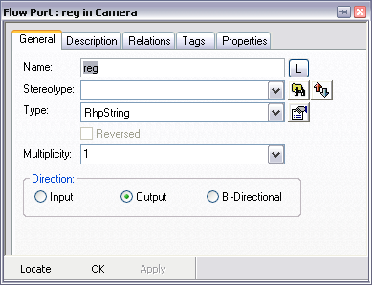
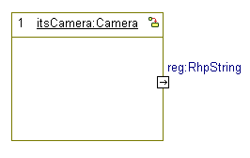
Port direction
For atomic Flow Ports
  The name and type must be the same as the Attribute that will flow.
Set the Ports type to RhpString.
  This will enable the direction field
Set the Port direction to Output.
Notes:
Course Title - Instructor Notes - Arial Narrow 20pt
Module X - Module Title

Slide 31
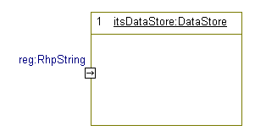
Add a Flow Port to the data store
Add a Flow Port to the DataStore in the same way.
  TIP: You can copy and paste Flow Ports in the Browser
  The only difference is the direction – this should be set to Input
Notes:
Course Title - Instructor Notes - Arial Narrow 20pt
Module X - Module Title

Slide 32
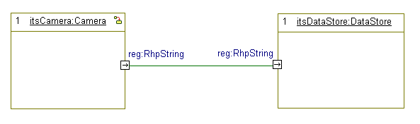
Connecting Ports
Connect the Flow Ports using a Connector
Notes:
Course Title - Instructor Notes - Arial Narrow 20pt
Module X - Module Title

Slide 33

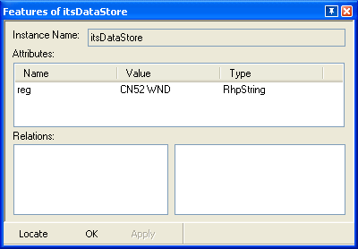
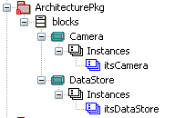
Run a Simulation
Build and execute the model
  The model is already web-enabled.
  Inject the evVehicleDetected Event again.
  Observe that when the Attribute value in the Camera changes, the changed value flows through the Port – updating the DataStore.
Notes:
Course Title - Instructor Notes - Arial Narrow 20pt
Module X - Module Title

Slide 34
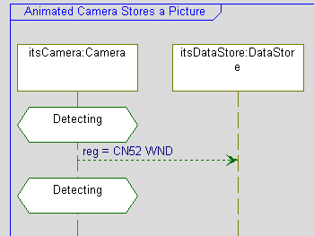
Animated Sequence Diagram
End the simulation
  Open the Camera Stores a Picture Sequence Diagram.
  Run the simulation again.
  Inject the Event as before.
    Note that the flow animates.
    Note also that repeated injections of the same Event do nothing.
      A Flow only occurs when the Attribute value changes
Notes:
Course Title - Instructor Notes - Arial Narrow 20pt
Module X - Module Title

Slide 35


Defining Change Events
Change Events may be used to trigger transitions when an Attribute value changes.
  End the simulation if it is still running.
  Add a new Event to the InterfacesPkg:
    Name it chReg
    Change events must be named the same as the attribute – with a ch prefix (and the name capitalized)
Notes:
Course Title - Instructor Notes - Arial Narrow 20pt
Module X - Module Title

Slide 36
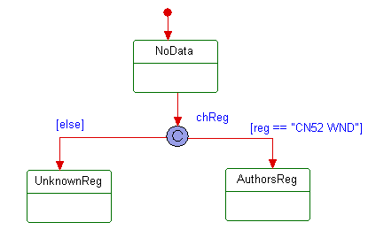
Using Change Events
Add a new State Machine to the DataStore.
Use Intellivisor to select the chReg Event previously defined
(you will need to browse to the InterfacesPkg to find it)
Notes:
Course Title - Instructor Notes - Arial Narrow 20pt
Module X - Module Title

Slide 37
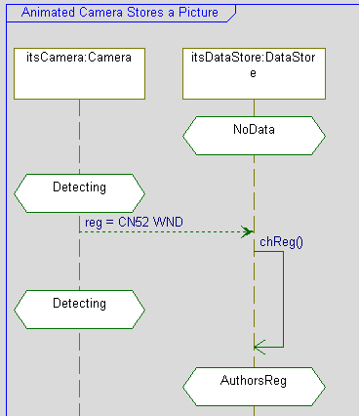
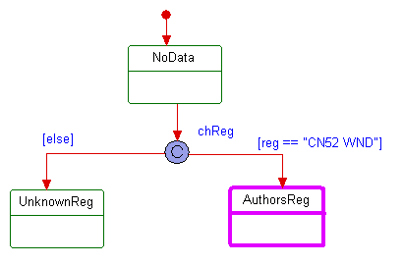
Model execution
Build and execute the model.
Confirm that the Change Event occurs:
Notes:
Course Title - Instructor Notes - Arial Narrow 20pt
Module X - Module Title

Slide 38
Atomic Flow Port summary
Atomic Flow Ports:
  Allow the flow of a single primitive Attribute.
  May be In or Out but not Bidirectional.
  Must have the same name and type as the Attribute value that is to flow.
Notes:
Course Title - Instructor Notes - Arial Narrow 20pt
Module X - Module Title

Slide 39
IBM Rational Rhapsody Advanced Systems Training v7.5
Non-Atomic Flowports
Notes:
Course Title - Instructor Notes - Arial Narrow 20pt
Module X - Module Title

Slide 40

Overview
So far, you have created atomic ports and transferred single data items across Flow Ports.
Flow Ports can also be non-atomic:
  Specified explicitly by Flow Specification.
  Specified implicitly using Flow Properties.
    Both contain flow attributes.
    Each Attribute can have its own direction.
The block must still have an Attribute with the same name and type as each flow Attribute in the Flow Port.
Notes:
Course Title - Instructor Notes - Arial Narrow 20pt
Module X - Module Title

Slide 41
Open a model
Launch Rhapsody.
From the menu:
  File > Open
Open the NonAtomicFlowPorts model.
Notes:
Course Title - Instructor Notes - Arial Narrow 20pt
Module X - Module Title

Slide 42

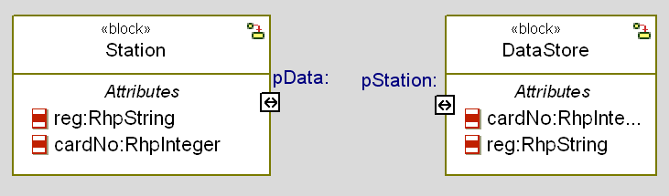
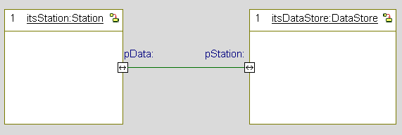
Architecture
Note the architecture:
Notes:
Course Title - Instructor Notes - Arial Narrow 20pt
Module X - Module Title

Slide 43

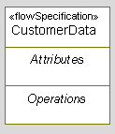
Create a Flow Specification
On the Block Definition Diagram:
  Select the Flow Specification tool
  Create a new Flow Specification
    Name it CustomerData
Notes:
Course Title - Instructor Notes - Arial Narrow 20pt
Module X - Module Title

Slide 44
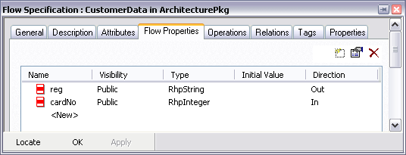
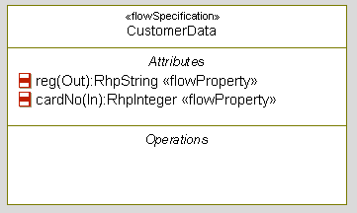
Populate the Flow Specification
In the Features View for the CustomerData Flow Specification, on the Flow Properties tab:
  Add two Flow Properties:
    Name: reg
    Type: RhpString
    Direction: Out
    Name: cardNo
    Type: RhpInteger
    Direction: In
Notes:
Course Title - Instructor Notes - Arial Narrow 20pt
Module X - Module Title

Slide 45
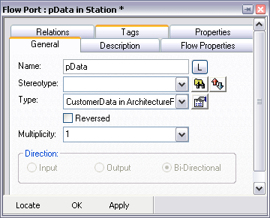
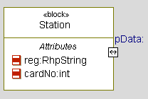
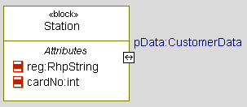
Modify the Flow Port (1)
In the Features View for the pData Flow Port on the Station:
  Change the Type to CustomerData.
Non-atomic ports have their direction grayed out.
The direction is specified in the Flow Specification.
Notes:
Course Title - Instructor Notes - Arial Narrow 20pt
Module X - Module Title

Slide 46



Flow Ports on Diagrams
If all the Flow Attributes in the Port are Output
  The Port symbol is Out
If all the Flow Attributes in the Port are Input
  The Port symbol is In
If there are mixed directions
  The Port symbol is bidirectional
Notes:
Course Title - Instructor Notes - Arial Narrow 20pt
Module X - Module Title

Slide 47
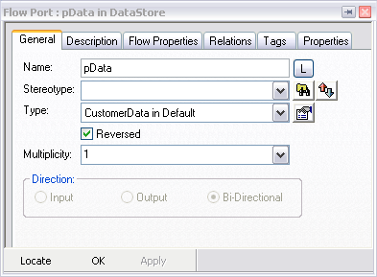

Modify the Flow Port (2)
In the Features View for the pData Flow Port on the DataStore:
  Change the Type to CustomerData.
  Check Reversed.
  Note that Rhapsody indicates a Reversed Port by coloring it in black.
Notes:
Course Title - Instructor Notes - Arial Narrow 20pt
Module X - Module Title

Slide 48

Station State Machine
Note the Station State Machine has already been created.
Change Event
Notes:
Course Title - Instructor Notes - Arial Narrow 20pt
Module X - Module Title

Slide 49

DataStore State Machine
Note the DataStore State Machine has already been created:
Notes:
Course Title - Instructor Notes - Arial Narrow 20pt
Module X - Module Title

Slide 50

Run a Simulation
Build and execute the model. Inject the evVehicleDetected Event into an animated sequence diagram by right-clicking on the lifeline.
Notes:
Course Title - Instructor Notes - Arial Narrow 20pt
Module X - Module Title

Slide 51
Atomic vs non-atomic Flow Ports
Atomic Flow Ports
  Atomic Flow Ports allow the flow of a single primitive Attribute.
  Atomic Flow Ports may be In or Out – not Bidirectional.
  The Attribute to be sent / received via the flow Port is specified by giving the Attribute and the flow Port the same name.
Non-atomic Flow Ports
  Only available in SysML models.
  Non-atomic Flow Ports are bi-directional.
  Can transfer a list of attributes (flow specification) or different types.
    Each Attribute may have a direction.
Flow Ports are linked in the same way as Standard Ports.
Notes:
Course Title - Instructor Notes - Arial Narrow 20pt
Module X - Module Title

Slide 52
Non-atomic Flow Port summary
Non-atomic Flow Ports:
  Specify multiple Attributes to Flow:
    Explicitly by Flow Specification
    Implicitly using Flow Properties
    Each Attribute may have a direction and a type.
    Sending / receiving Blocks must have a matching Attribute just as with atomic Ports.
  Are connected in the same way as Standard Ports using Connectors.
Notes:
Course Title - Instructor Notes - Arial Narrow 20pt
Module X - Module Title

Slide 53
IBM Rational Rhapsody Advanced Systems Training v7.5
Information Flow
Notes:
Course Title - Instructor Notes - Arial Narrow 20pt
Module X - Module Title

Slide 54

Information Flows - overview
Information flows describe the passing of data between elements at a high level of abstraction.
  They do not specify the nature of the data (type, initial value).
  They do not specify how the data is passed (the communication mechanism).
  They do not specify any sequence or control conditions.
  They do not execute in Rhapsody.
Although Information Flows may remain abstract – it is intended that, during detailed design, the actual details of the data and the communication mechanism used to convey it may be expressed.
Notes:
Course Title - Instructor Notes - Arial Narrow 20pt
Module X - Module Title

Slide 55


Information channels and items
Information flows consist of:
  An information channel:
    The route that the data flow takes.
    Represented by links, associations, dependencies.
  Information items:
    Shown attached to an information flow or to a relationship that realizes an information flow.
Notes:
Course Title - Instructor Notes - Arial Narrow 20pt
Module X - Module Title

Slide 56
Information items
An information item is an abstraction of all kinds of information that can be exchanged between objects.
  It is a kind of classifier intended for representing information at a very abstract way, one which cannot be instantiated.
  The purpose of information items is to be able to define preliminary models, before having made detailed modeling decisions on types or structures.
  Another purpose is to abstract complex models by a less precise but more general representation of the information exchanged between entities .
Notes:
Course Title - Instructor Notes - Arial Narrow 20pt
Module X - Module Title

Slide 57

Information item representation
Information Items can be decomposed (into more specific information items) using representation links between them.
Representation links may also be used between an information item and a classifier.
Notes:
Course Title - Instructor Notes - Arial Narrow 20pt
Module X - Module Title

Slide 58

Information items on flows / channels
Information Item on a flow
Information Item on a channel
Indicates that the information item is realized
Notes:
Course Title - Instructor Notes - Arial Narrow 20pt
Module X - Module Title

Slide 59
Open a model
Launch Rational Rhapsody.
From the menu:
  File > Open
Open the InformationFlow model.
  Open the Primary Uses Use Case Diagram
  Note that Information Flow is an abstract concept
    Here you will use it between Use Cases and Actors
    It could equally be applied between Blocks, Parts, Ports and so on.
Notes:
Course Title - Instructor Notes - Arial Narrow 20pt
Module X - Module Title

Slide 60

Create a Flow
Select the Flow tool:
  Draw a Flow between the Use Case and the DataStore Actor
  When the text cursor appears type Transaction Data and press Enter.
    This is a convenient way of adding the Information Flow and the Information Item at the same time.
    New Information Items can be added later.
Notes:
Course Title - Instructor Notes - Arial Narrow 20pt
Module X - Module Title

Slide 61



Information Flows and Items in the Browser
Note that Rhapsody calls these Flows and Flow Items
Allows Information Items to be mapped to real Types
Add new Information Items
Notes:
Course Title - Instructor Notes - Arial Narrow 20pt
Module X - Module Title

Slide 62
Summary
You are now able to use:
  Information Flows
  Non Atomic Flow ports
  Atomic Flow ports
  Event parameters

